Slide 1
Artificial Intelligence (AI)
Topic 2: Problem Solving Agents (Part -V)

Slide 2
Agenda
Uninformed Search Algorithms
Learning Outcomes : Searching Algorithms
Methodology and Assessment Criteria for the Subject

Slide 3
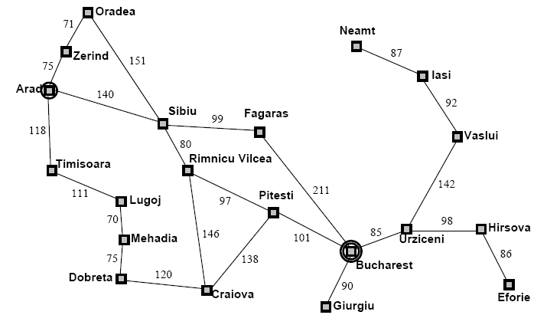
Example: Map Planning (1)

Slide 4
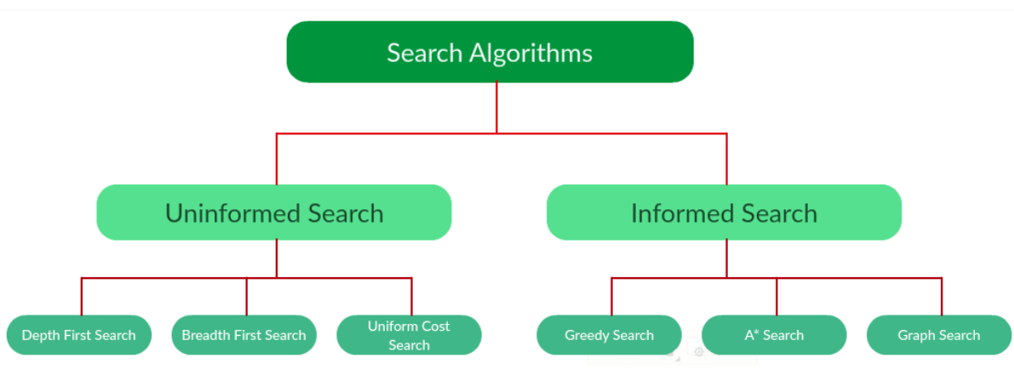
Types of Search Algorithms

Slide 5
Searching Strategies
Blind search 🡪 traversing the search space until the goal nodes is found (might be doing exhaustive search).
Techniques : Breadth First Uniform Cost ,Depth first, Interactive Deepening search.
Guarantees solution.
Heuristic search 🡪 search process takes place by traversing search space with applied rules (information).
Techniques: Greedy Best First Search, A* Algorithm
There is no guarantee that solution is found.

Slide 6
Example: Traveling Salesperson Problem
Suppose a salesperson has five cities to visit and them must return home. Goal 🡪 find the shortest path to travel.
A
B
75
125
125
100
75
E
50
125
C
50
D
100

Slide 7
Searching for Solution
Search through state space (explicitly using searching tree).
Node expansion :- generating new node related to previous nodes.
Concepts:
State :- conditions in which the node corresponds.
Parent node :- the superior node
Path cost :- the cost, from initial to goal state.
Depth:- number of steps along the path from initial state

Slide 8
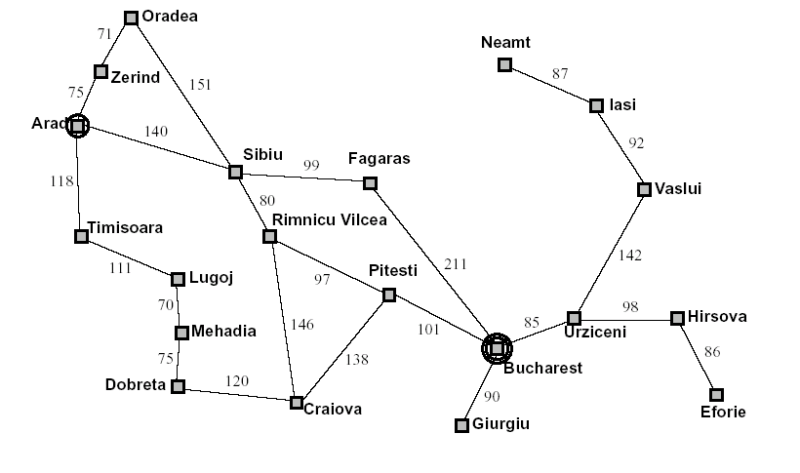
Node expansion

Slide 9
Measuring Searching Performance
The output from problem-solving (searching) algorithm is either FAILURE or SOLUTION.
Four ways:
Completeness : is guaranteed to find a solution?
Optimality: does it find optimal solution ?
Time complexity: how long?
Space complexity: how much memory?
Complexity : branching factor (b), depth (d), and max. depth (m)

Slide 10
Infrastructure of Search Algorithm (1)
Search Algorithm require data structure to keep track of the search tree that is being constructed.
For each node n of the tree we have structure that contain 4 components:
n. STATE: The State Space in which the node corresponds
n.PARENT: The node in the search tree that generated this node
n.ACTION: The Action that was applied to the parent to generate that ` node0
n.PATH COST: This is traditionally denoted by g(n), of the path from the initial state to the node, as indicated by parent pointers

Slide 11
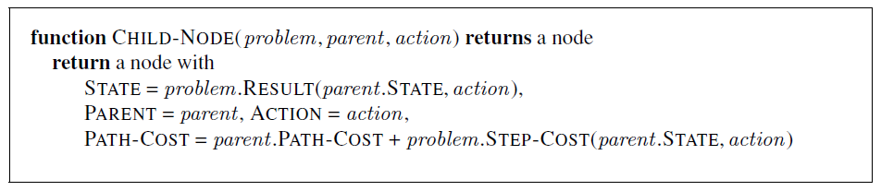
Infrastructure of Search Algorithm (2)
Given the components of Parent Node it is easier to Compute the necessary components of a Child –Node

Slide 12
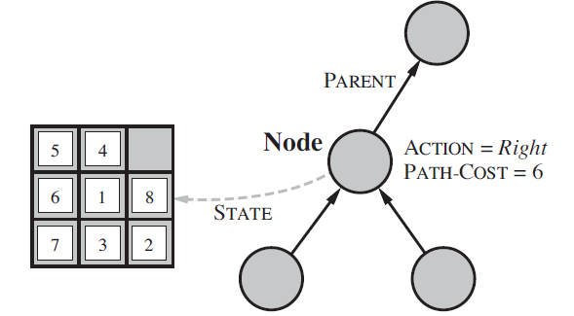
Infrastructure of Search Algorithm (3)
Nodes are data structures from which the search tree is constructed. Each has a parent, state and various book keeping fields. Arrows here point from child to node
The PARENT pointers string the node together into tree structures
These pointers also allow solution path to be extracted when a goal node is found
We use SOLUTION function to return sequence of actions obtained by following parent pointers back to the root

Slide 13
Infrastructure of Search Algorithm (4)
When writing a detailed algorithm distinguish the difference between the node and the state. Node is a book keeping data structure used to represent a search tree. Nodes are on a particular path as highlighted by the PARENT pointers
A state corresponds to the configuration of the world and two nodes can represent the same world state if that state is generated by two search paths.
As we have nodes we need to put them somewhere. The frontier, needs to be stored in such a way that search algorithm can easily choose the next node to expand as per strategy. The appropriate data structure for this is Queue with EMPTY, POP and INSERT operations with the variants LIFO and FIFO

Slide 14
Infrastructure of Search Algorithm (5)
Explored set of states can be implemented with a hash table to allow efficient checking of the repeated states.
In Artificial Intelligence the time and space complexity of a Graph is measured by three quantities:
b, branching factor: maximum number of successors of a node
d, depth, the shallowest goal node (i.e the number of steps along the path from the root
m, maximum length of any path in the state space
We finally determine the search cost which includes both Time and Space Complexity measure based Edges, E and vertices,V

Slide 15
Formal definition of graphs
A graph G is defined as follows:
G=(V,E)
V(G): a finite, nonempty set of vertices
E(G): a set of edges (pairs of vertices)

Slide 16
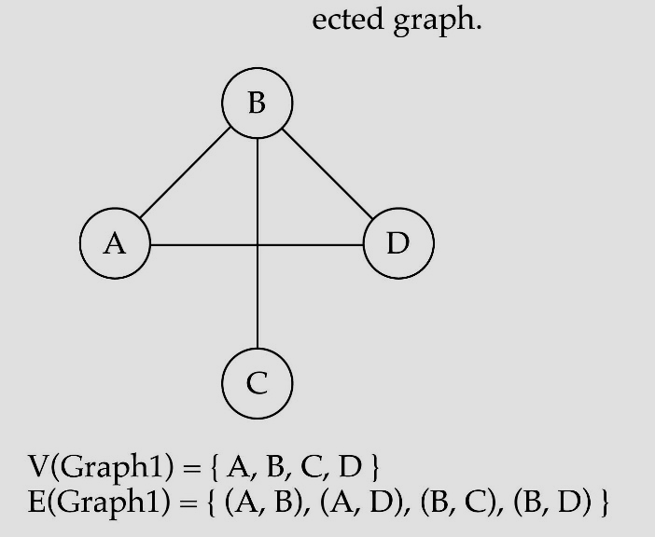
Directed vs. undirected graphs
When the edges in a graph have no direction, the graph is called undirected

Slide 17

Directed vs. undirected graphs (cont.)
When the edges in a graph have a direction, the graph is called directed (or digraph)
Warning: if the graph is directed, the order of the vertices in each edge is important !!
E(Graph2) = {(1,3) (3,1) (5,9) (9,11) (5,7)

Slide 18

Trees vs graphs
Trees are special cases of graphs!!

Slide 19
Breadth-First Search
Recall from Data Structures the basic algorithm for a breadth-first search on a graph or tree
Expand the shallowest unexpanded node
Place all new successors at the end of a FIFO queue

Slide 20

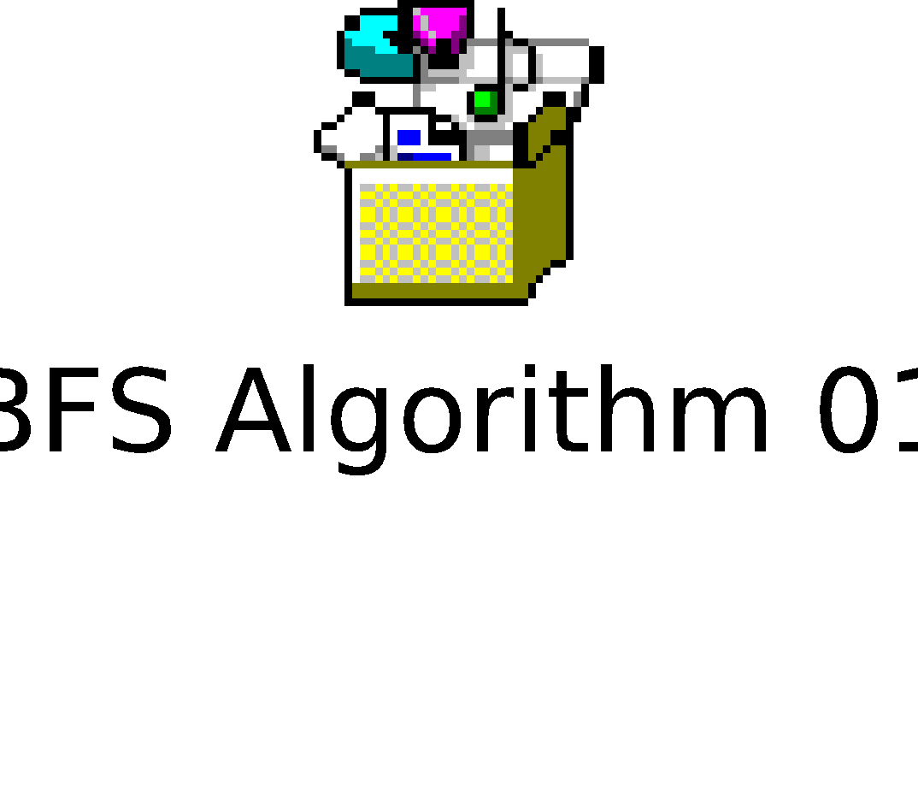
Breadth-First Search (1)
A Directed graph BFS Algorithm

Slide 21
Learning Outcomes with the Topic
Understanding the need of Search Algorithms

Slide 22
Methodology And Assessment Criterias
Class Assignment(s)
Each chapter being covered will have one assignment. The Case Studies will be given in line to the Changing with Speed across IT Projects in Kirirom
Internal Exam(s)
There will be 2 exams
Model Exam
There will be one Model Exam.
Semester Exam
There will be 1 Semester Exam

Slide 23

Thank You !
“An Algorithm Must Be Seen to Be Believed”
- Donald Knuth

